Slide 1
CyberSpaceSuite
Know the Network, Secure the Network and Defend the Network
Cyberspace Analytics and Cadia Networks

Slide 2
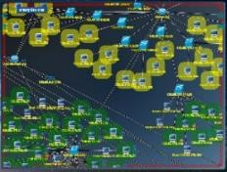
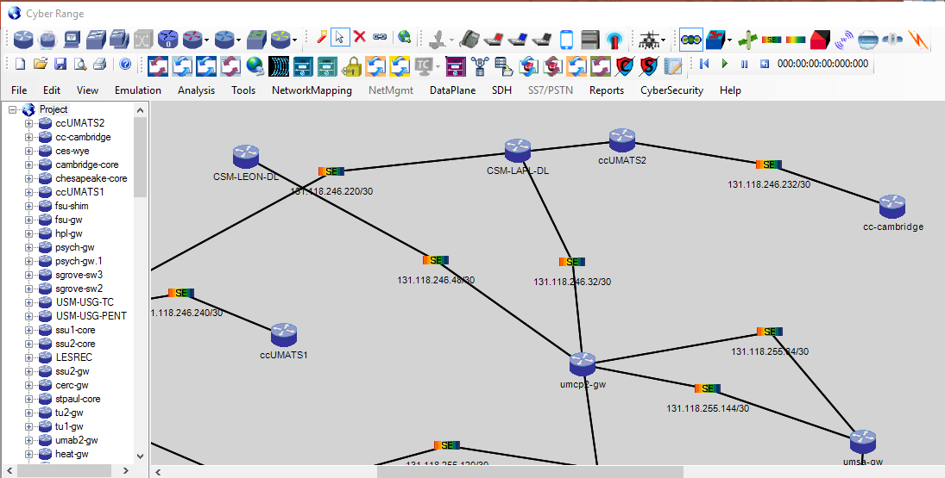
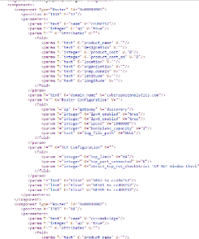
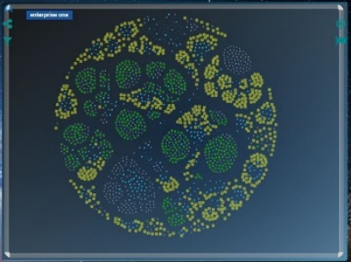
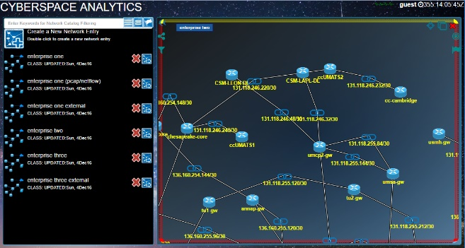
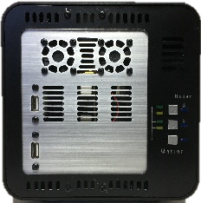
CyberSpace Analytics: Network Mapping
Map the Network
Clone the Network
Correlates Data-sets into one cohesive map
User Interface
CyberSpace Appliance
6.5” (H)
6.5” (W)
9” (L)
8lbs
Export Network
Interface CyberSpace Range with Physical Devices
(VM Clusters, Real Routers, Real Hosts, Another CyberSpace Range)
Mapping Accomplishments
CyberSpace Appliance Usages
Real Networks
Sensitive Networks
UMBC Network
Maryland Research & Education Network (MDREN)
Louisiana State University Network (LSU)
Louisiana State Network - LONI
Real Situational Awareness
User-defined Visual enrichments
On-demand IP and attribute searching
On-demand Network Reports
Streaming analytics verifying Network Configuration
Advance analytics categorizing end-node behavior
Cyber Training
Train analyst on real network clone how to operate
Train network administrator on real network behavior
Cyber Testing
Plug-and-play testing of virtual/real servers
Use various loading patterns and network topologies
Test against network disaster scenarios
Cyber Sandbox
Conduct malware analysis
Cyber Honeypot
Observe hacker activities
Deploy decoy networks
Massive CyberSpace Range Scaling Supported
Cascade Appliances, Many Autonomous Systems, Large Network Topology, 1000s of Nodes

Slide 3
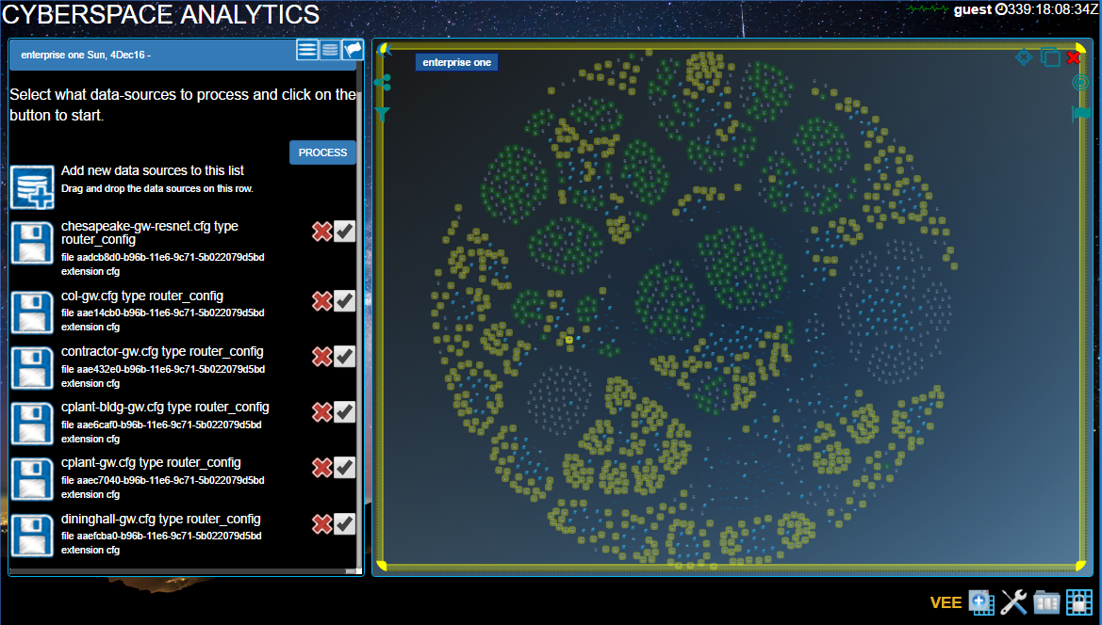
CyberSpace Analytics: Map the Network
Reverse-engineer, map, enrich, and visualize networks
Green background are Secure Zoned Nodes
Yellow background are Academic Zoned Nodes
63 Router Configs
27 NMAP Scans
24 Hrs of Palo Firewall Logs
Enrichment Descriptor
Application Information Logs
Network-based Devices Output
Vulnerability/Scanning Results
DNS and other lookup tools
Security Intelligence Feeds
Packet-based Detection Results
Baseline Network Map and Behavior
Understand Vulnerabilities/Assets
Optimize Defensives
Visibility in Endpoint/User/Location
Connect the dots on Intrusions
Enhance external Security Intelligence

Slide 4
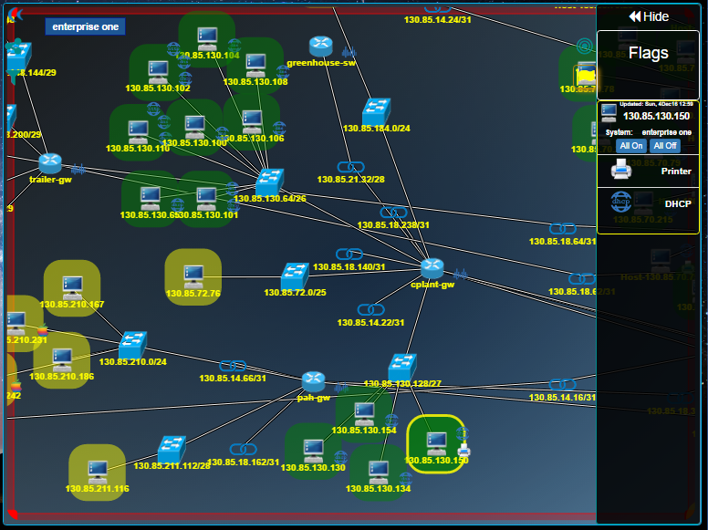
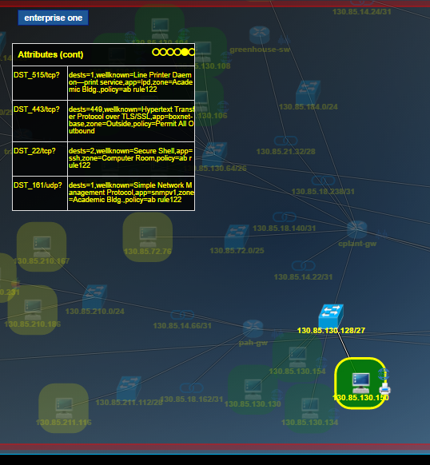
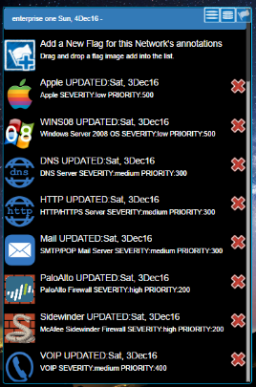
CyberSpace Analytics: Map the Network
Advanced Analytics: Display Node Attributes
Hover over Node
Review System Information
Review Interfaces
Review Flow Behavior
Display Selected Node Attributes as Custom Flags
Select pre-set flags or create a new flag

Slide 5
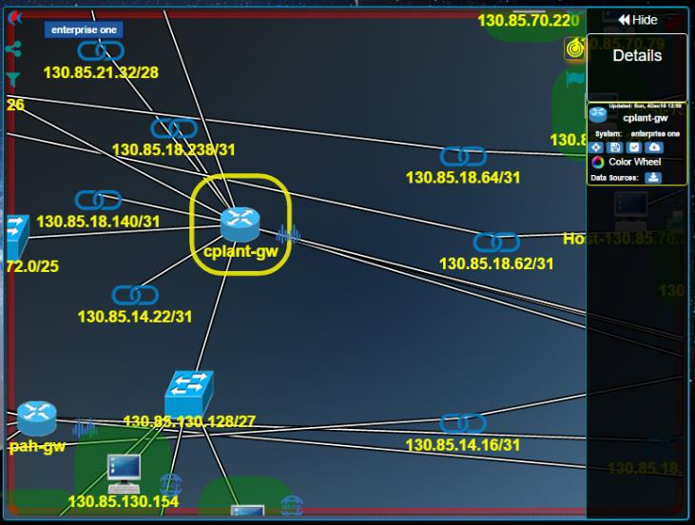
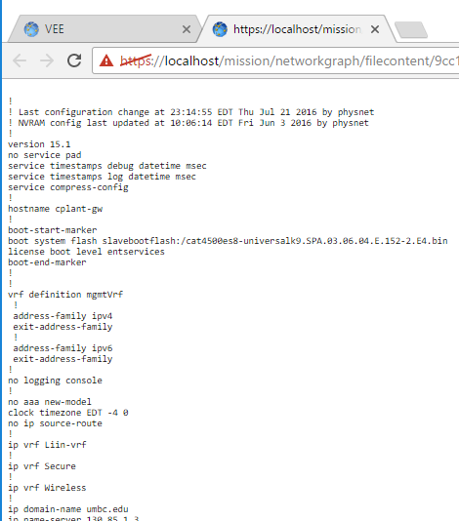
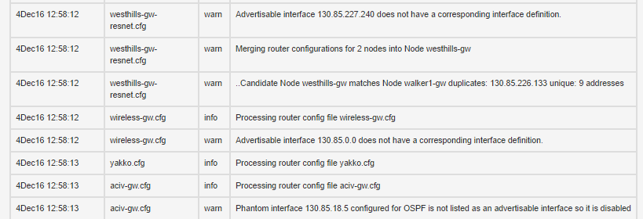
CyberSpace Analytics: Map the Network
Advanced Analytics: Router Configs and Mapping Logs
Display Raw Router Configuration associated with Node
Review Mapping Log for Network Configuration Collisions
Identify duplicate interface definitions
Identify Phantom Interfaces

Slide 6
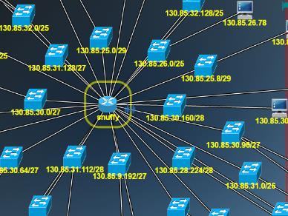
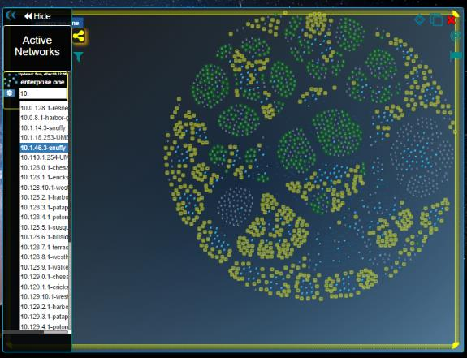
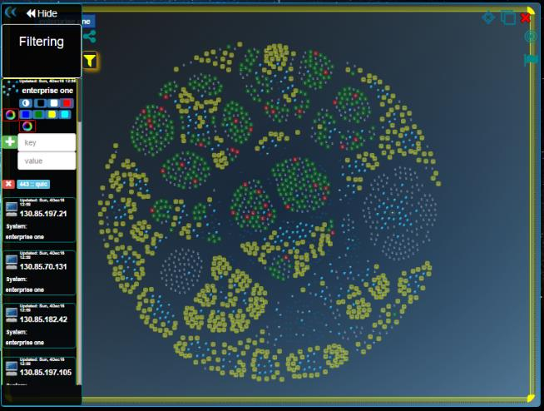
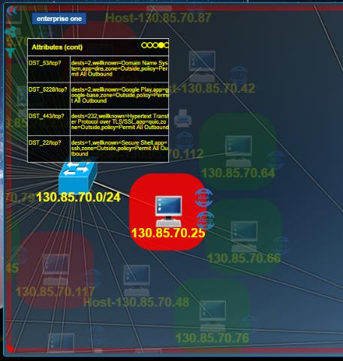
CyberSpace Analytics: Map the Network
Advanced Analytics: Search Nodes By IP or Attribute
Fly-to the Node of interest
Fly-to the Node of interest
Search by IP and Select Network Node to Fly-to
Search for protocol QUIC (SSL over UDP)
Highlight all QUIC servers red.
Examine a Node running QUIC service
Fingerprinted by Firewall Log

Slide 7
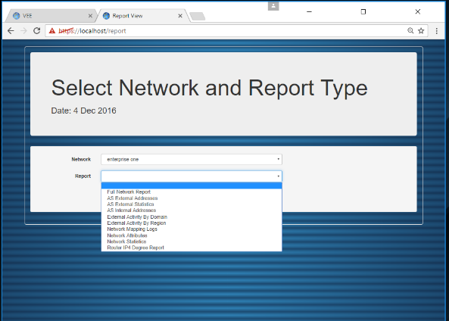
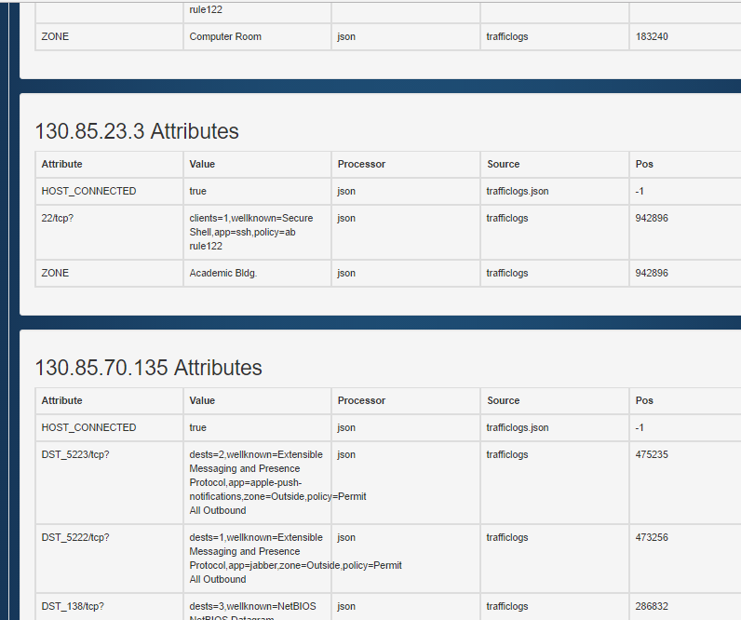
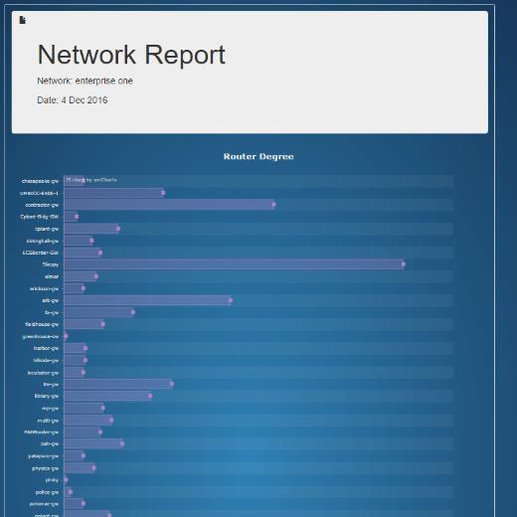
CyberSpace Analytics: Map the Network
Advanced Analytics: Network Reports
Select Report to Generate
Node Attribute Report
Router Degree Report

Slide 8
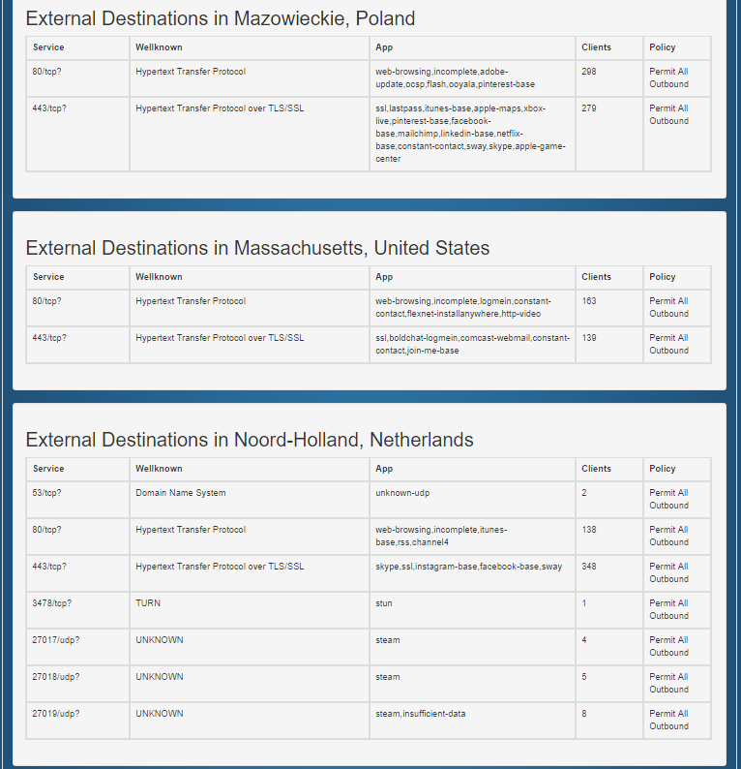
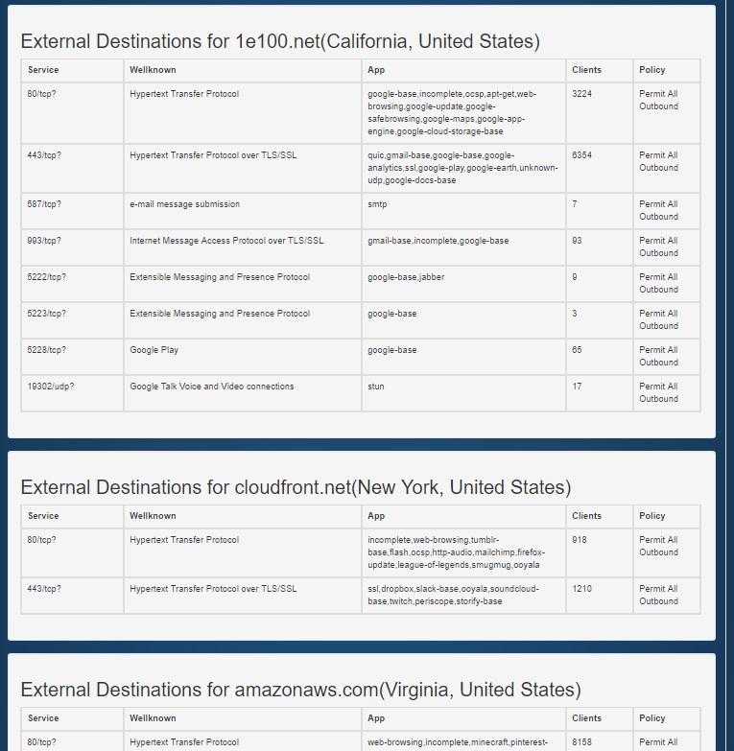
CyberSpace Analytics: Map the Network
Advanced Analytics: External Clients/Destinations
Review who inside is talking to outside by region.
Review who inside is talking to outside by domain.

Slide 9
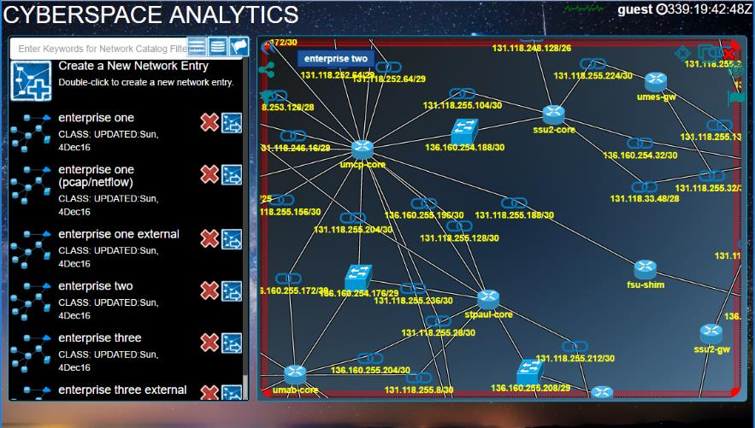
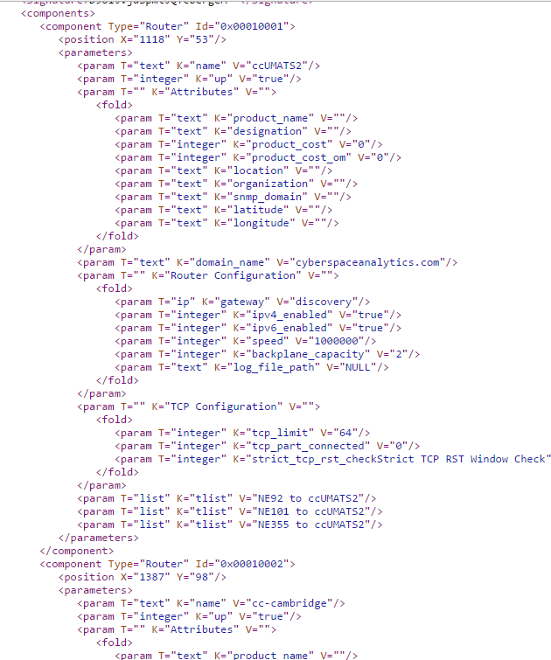
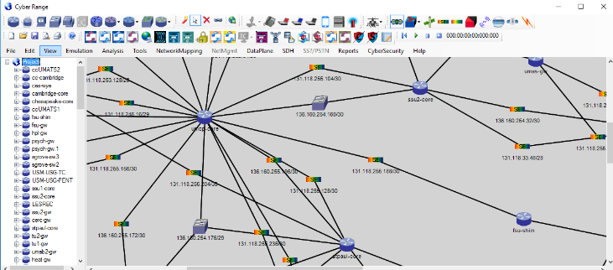
CyberSpace Analytics: Map the Network
Advanced Analytics: Export Network Map for CyberSpace Range
Save Export
Export Network Map
CyberSpace Appliance Interface
CyberSpace Range Appliance
6.5” (H) x 6.5” (W) x 9” (L)
8lbs

Slide 10
CyberSpace Appliance: Clone the Network
CyberSpace Appliance
Physical Attributes
Small form factor
Tool box size
< 9 lbs
Portable
Commodity H/W
Configurable in minutes
Live-virtual integration
Plug-and-play systems/networks
Extensible
Daisy-chain CyberSpace Range Appliances
Hardware/Software
All major networks
Wired, wireless, mobile
TCP/IP, …
All major real/virtualized systems
Servers, databases, application
All major security technologies
Firewalls, VPNs, IDs/IPs, …
All major packet capture tools
All major packet/flow analysis tools
All major malware analysis tools
Honeypot Environment
Isolated range for Malware Analysis
Observe hacker activities
Gather forensic information
Deliver dummy content
Deploy decoy networks
Testing Environment
Network Administrator Development
Network Disaster Recovery Scenarios
Network Planning Scenarios
Network Troubleshooting Analysis
Training Environment
Realistic, Full-fidelity, Rapidly configurable
CyberSpace Operations Training
DCO, OCO, DODIN
Cyber Defense Exercises (CDX)
Cyber Capture the Flag (CTF)
Cyber Exercises/Rehearsals
Cyber Skills Testing/Certification

Slide 11
CyberSpace Appliance: Clone the Network
CyberSpace Appliance Interface
CyberSpace Appliance Architecture
Full Visibility
Optimize Performance
Baseline Network
Understand Network
Links threat/assets
Connect the dots
Cyber Training
Cyber Testing
Cyber Sandbox
Cyber Honeypot
Cluster A VMs
Cluster B VMs
OSPF
RIP
IGP
EGP
IPv4
IPv6
MPLS
IPSec
Tunnel
Powered by VEETM

Slide 12
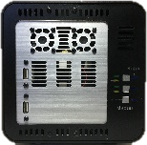
CyberSpace Appliance: Clone the Network
Network
Honeypot
Application
Network
Testing
Application
Cyber
Training
Application
HoneyPot
Cloned Topology
Real Network
Network Penetration Testing
Network Device Testing
Force-on-Force Exercises
Capture the Flag Scenarios
WAN
Extended CyberSpace Range
Isolated Sandbox for Malware Analysis
OSPF
RIP
IGP
EGP
IPv4
IPv6
MPLS
IPSec
Tunnel

Slide 13
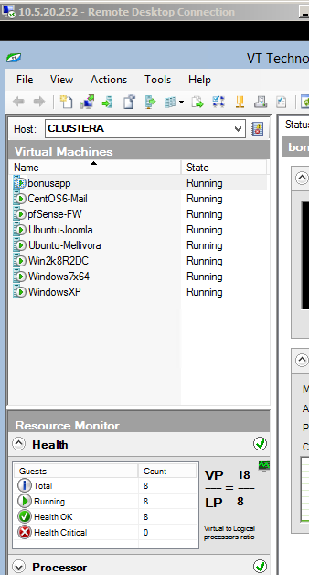
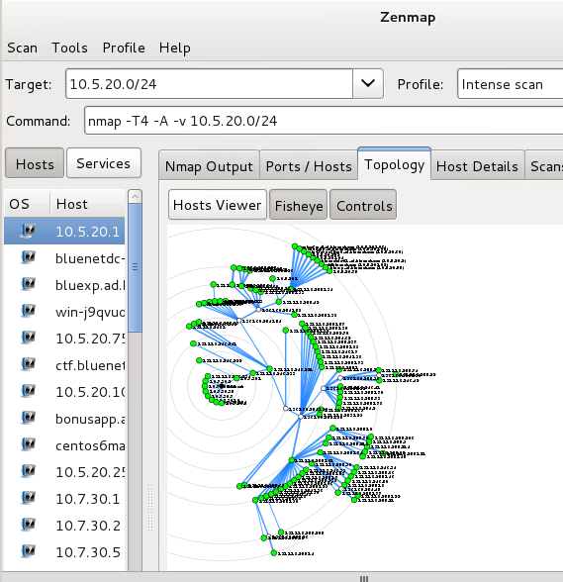
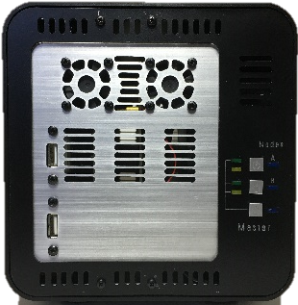
CyberSpace Appliance: Clone the Network
Run Exported Network in CyberSpace Appliance
Full Visibility
Optimize Performance
Baseline Network
Links threat/assets
Connect the dots
CyberSpace Appliance User Interface
Flow of Events in Video
Run Exported Network
Run NMAP Scan from VM in Cluster B
Probe Cloned Network
Display Packets
Access Router Shell
Display Routing Table
Cluster A VMs
Cluster B VM
Training, Testing, Sandbox, and Honeypot CyberSpace Appliance
NMAP Results

Slide 14
CyberSpaceSuite: Summary
Scalable and Seamlessly Integrated Cyberspace Analytics
Know Your Network
Reverse-Engineer, Map and Visualize Network End-to-End from Raw Data Captures
Understand network segmentations, tunnels, boundary nodes, Firewalls and NATs, servers
Understand data flows out (insider attacks) of your network and into your network (external reputations)
Update network map using real-time network configuration changes
Create near real-time network situational awareness and Virtual Network Operations Center (V-NOC)
Secure Your Network
Harden network against vulnerabilities to improve security posture
Validate network configurations against policies/compliances (FISMA, PCI, HIPPA, GLB, SOX, NERC, STIGs)
Update network cyber state using data from National Vulnerabilities Database (NVD) and other databases
Reduce network attack surface; optimally place network services (e.g. DHCP. DNS) for survivability
Create near real-time cyber situational awareness and Virtual Security Operations Center (V-SOC)
Defend Your Network
Create Network Clone from Network Map in a bit-accurate IP/TCP RFC-compliant
Emulate Cloned Network in CyberSpace Appliance to gain unprecedented insight into network operations
Extend Cloned Network by connecting physical devices/networks to ports on CyberSpace Range Appliance
Use CyberSpace Appliance as HoneyPot to understand attackers and Zero-Day attacks, automated alerting to network IPSs to isolate critical network resources from malware propagation and support incident response
Create realistic and full-fidelity cyber training/certification environment for cyber warriors

